Slide 1
Chapter 8
Introduction to
Responsive Web Design

Slide 2
Objectives
Applied
Given an HTML document that uses a fixed layout, convert it so it uses fluid widths, scalable images, and inherited fonts.
Given an HTML document that uses a fluid layout, add media queries that change the appearance of the page depending on the size of the screen it is displayed on.
Use the SlickNav plugin to replace the navigation menu on smaller screen sizes.
Use the browser developer tools to test your responsive designs.
Knowledge
Describe three components of a Responsive Web Design.
Describe three basic ways that you can test a responsive design.

Slide 3
Objectives (cont.)
Explain how fluid layouts compare to fixed layouts.
Explain why you should use relative font sizes with a responsive design.
Describe the use of the meta element for setting the viewport on mobile devices.
Describe the basic syntax of a media query.
Describe two approaches for developing the media queries for a responsive design.

Slide 4
What is RWD?
(Responsive Web Design)

Slide 5
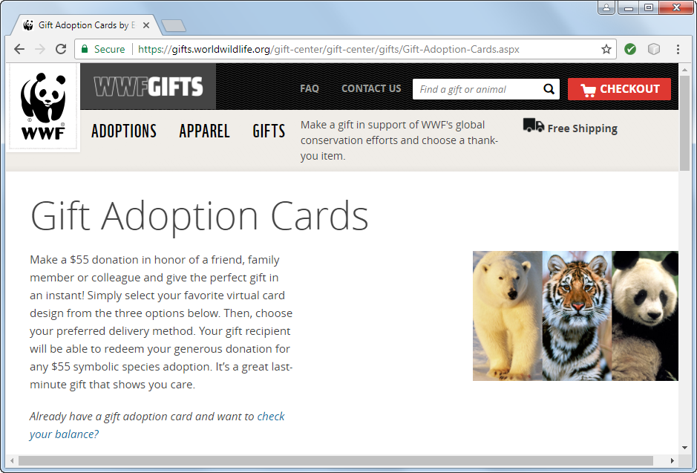
A website that uses RWD: Desktop

Slide 6
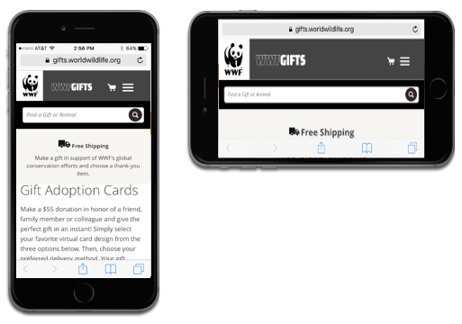
A website that uses RWD: Mobile

Slide 7
Three components of Responsive Web Design
Fluid layout
Media queries
Scalable images

Slide 8
Testing RWD
(Responsive Web Design)

Slide 9
Three ways to test a responsive design
Deploy your website to a server and then test it on each device.
Use device emulators, browser simulators, and virtual machines for the various devices and browsers you want to test.
Use the developer tools provided by most modern browsers.

Slide 10
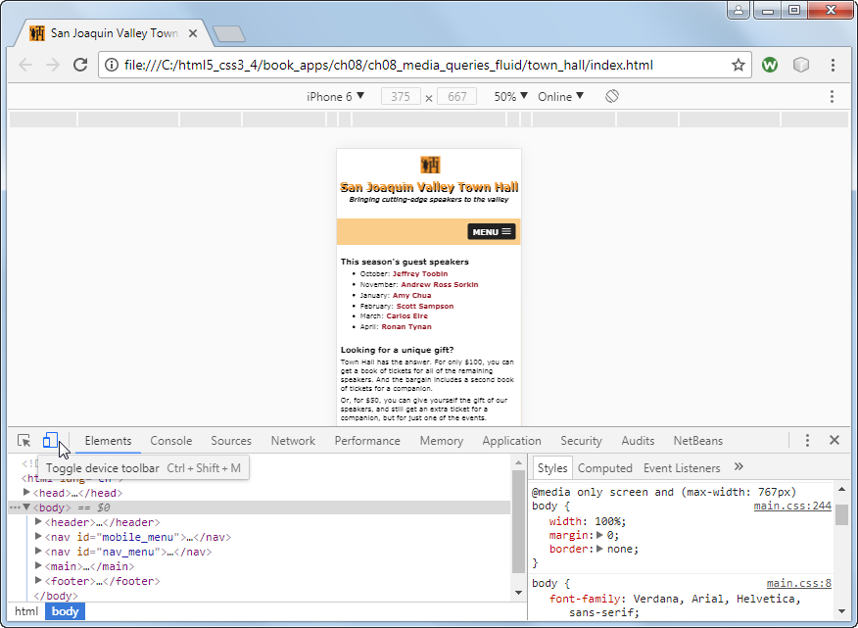
A web page in Chrome’s developer tools

Slide 11
Fluid Layouts
with % or viewport units

Slide 12
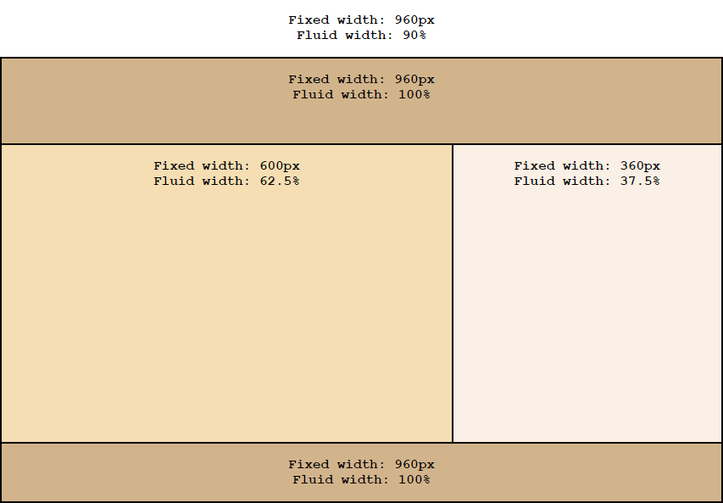
Fixed and fluid widths in a two-column layout

Slide 13
The benefits of fluid layouts
Page layouts are proportional to the size of the screen, so they will fill the screen equally at all sizes.
They are scalable, so when new screen sizes become available in the future, they will automatically adapt to those new sizes.
They can be used without media queries in some cases, although that’s not common.

Slide 14
A formula for converting pixels to percents
target ÷ context x 100 = result
The HTML for a page with padding and borders
<body>
<header><p>This is the text for the header.</p>
</header>
<main><p>This is the text for the main element.</p>
</main>
<aside><p>This is the text for the aside.</p>
</aside>
<footer><p>This is the text for the footer.</p>
</footer>
</body>

Slide 15
The CSS for a fluid layout
body {
width: 90%; /* changed from 960px */
max-width: 1024px; /* maximum width of page */
}
header {
width: 100%; /* 960 ÷ 960 x 100 */
}
main {
width: 62.5%; /* 600 ÷ 960 x 100 */
}
aside {
width: 37.5%; /* 360 ÷ 960 x 100 */
}
footer {
width: 100%; /* 960 ÷ 960 x 100 */
}

Slide 16
Relative units of measure for responsive design
vh 1% of viewport height
vw 1% of viewport width
vmin 1% of the smallest dimension
wmax 1% of the largest dimension

Slide 17
The HTML for a simple page
<body>
<header>
<h1>San Joaquin Valley Town Hall</h1>
</header>
<main>
<p>Welcome to San Joaquin Valley Town Hall. We
have some fascinating
speakers for you this season!</p>
</main>
</body>
CSS that sets the width of the body based on the width of the viewport
body {
width: 95vw; /* equivalent to 95% */
margin: 0 auto;
}
book_examples/ch08/05_vw_units.html
Notes:
This example does a very poor job of illustrating the value of viewport units.

Slide 18
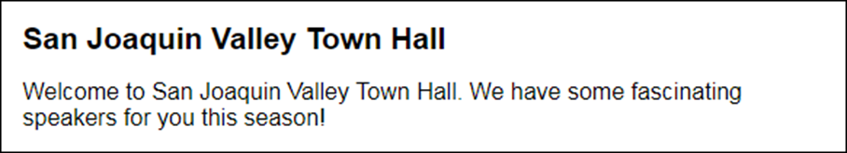

The page when the viewport is 580 pixels wide
The page when the viewport is 412 pixels wide
book_examples/ch08/05_vw_units.html
Notes:
This example does a very poor job of illustrating the value of viewport units.

Slide 19

CSS that sets the width based on the minimum dimension of the viewport
body {
width: 95vmin;
margin: 0 auto;
}
The page when the viewport is 580 pixels wide and 180 pixels tall
book_examples/ch08/05_vmin_units.html
Notes:
This example does a very poor job of illustrating the value of viewport units.

Slide 20
The HTML for a page with different font sizes
<body>
<header><h2>San Joaquin Valley Town Hall</h2>
</header>
<main>
<h1>This season's guest speakers</h1>
<ul>
<li>...</li>
<li>...</li>
<li>...</li>
</ul>
<p>Please contact us for tickets.</p>
</main>
<aside>
<h3>Lecture day, time, and location</h3>
<p>...</p>
</aside>
<footer>
<p>&copy; Copyright 2018 San Joaquin Valley Town
Hall.</p>
</footer>
</body>
Notes:
The HTML isn't really relevant to this example.

Slide 21
Relative Font Sizes
with %, em, or rem

Slide 22
CSS that specifies the font sizes in ems
body {
font-size: 100%; /* 16 pixels */
width: 90%;
max-width: 1024px;
margin: 0 auto;
border: 2px solid black;
}
h1 { font-size: 1.75em; } /* 28 ÷ 16 */
h2 { font-size: 1.5em; } /* 24 ÷ 16 */
h3 { font-size: 1.125em; } /* 18 ÷ 16 */
footer p { font-size: .75em; } /* 12 ÷ 16 */
How to calculate the font size in ems
Divide the font size in pixels by 16.
How to calculate the font size as a percent
Multiply the result of the calculation above by 100.

Slide 23
Scaling Images
with CSS max-width

Slide 24

Scaling images with a fluid layout
book_examples/ch08/07_scale_images.html

Slide 25
The HTML for the image
<img src="images/students.jpg"
alt="Instructor with students">
Remove any height and width attributes from the HTML for the image!
The CSS for the image
section img {
/* causes image to be scaled down but not up */
/* width limited to native width of image */
max-width: 100%;
}
Another method
section img {
/* width limited to 400px */
width: 100%;
max-width: 400px;
}
book_examples/ch08/07_scale_images.html

Slide 26
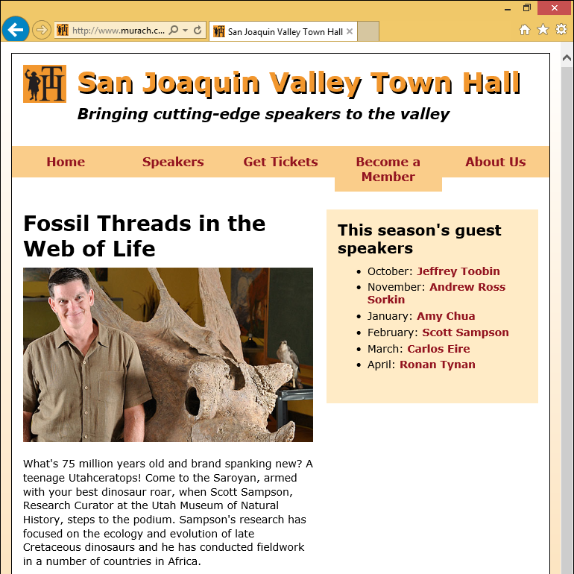
A page with a fluid layout
book_apps/ch08/c08_fluid/town_hall/sampson.html

Slide 27
Viewport Metadata
<meta name="viewport" content="…">

Slide 28
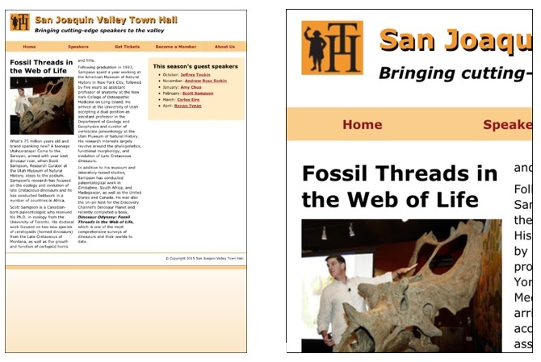
A web page on a mobile device without and with a meta viewport element
book_apps/ch07/town_hall/sampson.html

Slide 29
Content properties for viewport metadata
width logical width of viewport
height logical height of viewport
initial-scale initial zoom factor
minimum-scale smallest allowed zoom factor
maximum-scale largest allowed zoom factor
user-scalable yes/no
A meta element that sets viewport properties
<meta name="viewport"
content="width=device-width, initial-scale=1">

Slide 30
CSS Media Queries
@media screen

Slide 31
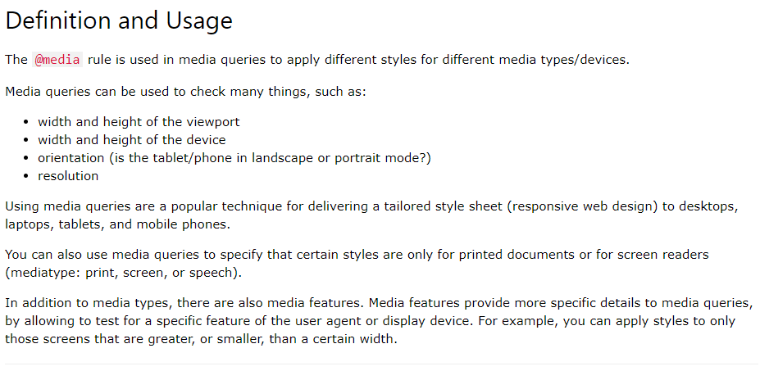
CSS Media Queries
https://www.w3schools.com/cssref/css3_pr_mediaquery.asp

Slide 32
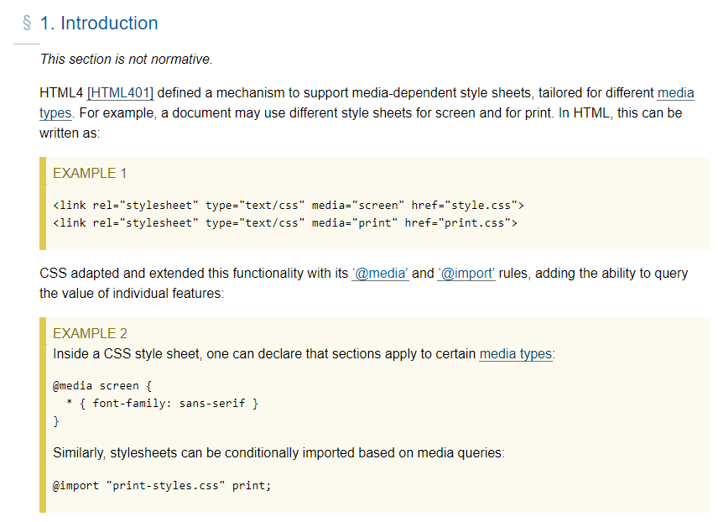
CSS Media Queries
https://www.w3.org/TR/mediaqueries-4/

Slide 33
Common properties for the screen media type
The basic syntax of a media query
@media [only] media-type [and (expression-1)] [and (expression-2)]... {
...styles go here
}
width width of the viewport
height height of the viewport
orientation landscape or portrait
Example: viewport width is 767 pixels or less
@media only screen and (max-width: 767px) {...}
Example: viewport width is between 480 and 767 pixels
@media only screen and (min-width: 480px)
and (max-width: 767px) {...}

Slide 34
Media queries for a desktop-first design
/* tablet landscape and desktop layout (960px or more) */ ...tablet landscape and desktop styles go here
/* tablet portrait layout (768px to 959px) */
@media only screen and (max-width: 959px) {
...tablet portrait styles go here }
/* mobile landscape layout (480px to 767px) */
@media only screen and (max-width: 767px) {
...mobile landscape styles go here }
/* mobile portrait layout (479px or less) */
@media only screen and (max-width: 479px) {
...mobile portrait styles go here }

Slide 35
Media queries for a mobile-first design
/* mobile portrait layout (479px or less) */
...mobile portrait styles go here
/* mobile landscape layout (480px to 767px) */
@media only screen and (min-width: 480px) {
...mobile landscape styles go here
}
/* tablet portrait layout (768px to 959px) */
@media only screen and (min-width: 768px) {
...tablet portrait styles go here
}
/* tablet landscape and desktop layout (960px or more) */
@media only screen and (min-width: 960px) {
...tablet landscape and desktop styles go here
}

Slide 36
SlickNav
mobile-friendly navigation menu

Slide 37
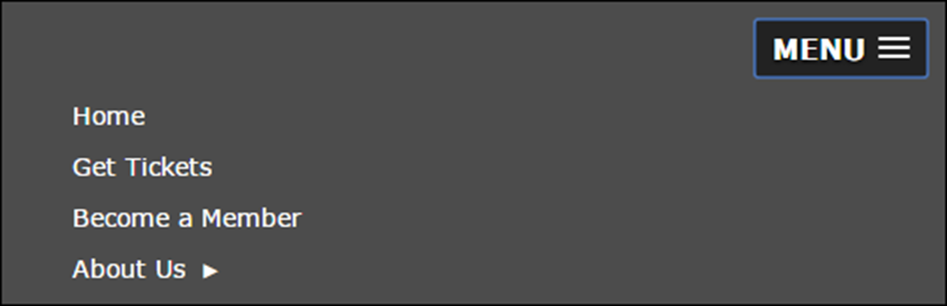
A multi-tier menu that uses SlickNav
Code for the SlickNav plugin in the head element
<link rel="stylesheet" href="styles/slicknav.css">
<script src="https://code.jquery.com/jquery-3.5.1.min.js"></script>
<script src="js/jquery.slicknav.min.js"></script>
<script type="text/javascript">
$(function() {
$('#nav_menu').slicknav({prependTo:'#mobile_menu'});
});
</script>
Get the newest version of jQuery from https://code.jquery.com/

Slide 38
HTML for the SlickNav and navigation menus
<nav id="mobile_menu"></nav>
<nav id="nav_menu">
<ul>
<li><a href="index.html">Home</a></li>
.
.
</ul>
</nav>
CSS for the SlickNav menu
@media only screen and (max-width: 767px) {
/* hide the desktop menu */
#nav_menu { display: none; }
/* show the mobile menu */
#mobile_menu { display: block; }
}
book_apps/ch08/c08_media_queries_fluid/town_hall/sampson.html

Slide 39
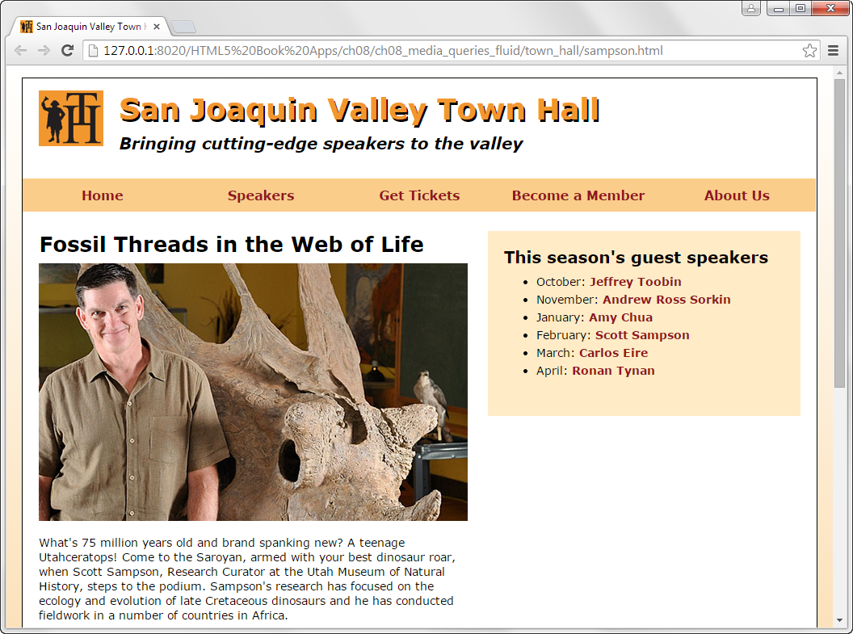
A speaker page in desktop layout
book_apps/ch08/c08_media_queries_fluid/town_hall/sampson.html

Slide 40
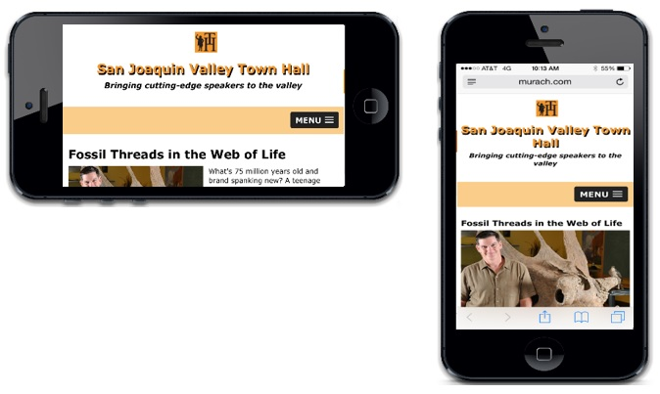
A speaker page in mobile layout
book_apps/ch08/c08_media_queries_fluid/town_hall/sampson.html

Slide 41

Short 8-1 Create a fluid design

Slide 42
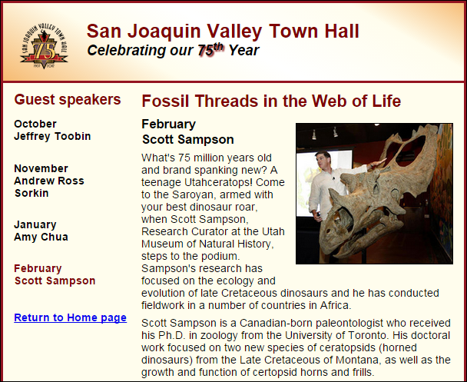
Short 8-2 Add a media query

Slide 43
Objectives
Applied
Given an HTML document that uses a fixed layout, convert it so it uses fluid widths, scalable images, and inherited fonts.
Given an HTML document that uses a fluid layout, add media queries that change the appearance of the page depending on the size of the screen it is displayed on.
Use the SlickNav plugin to replace the navigation menu on smaller screen sizes.
Use the browser developer tools to test your responsive designs.
Knowledge
Describe three components of a Responsive Web Design.
Describe three basic ways that you can test a responsive design.

Slide 44
Objectives (cont.)
Explain how fluid layouts compare to fixed layouts.
Explain why you should use relative font sizes with a responsive design.
Describe the use of the meta element for setting the viewport on mobile devices.
Describe the basic syntax of a media query.
Describe two approaches for developing the media queries for a responsive design.

Slide 45
Assignments
Reading assignments on Perusall
Homework and Labs on InsideRanken

